Slide 1

Population Quick Recap
Population of Deer
0 40 80 120 160 200 240 260 280
Too many deer for the ecosystem to support
Carrying capacity (K)
Factors?
Density dependent
Density independent
Biotic
Abiotic
Logistic Growth
’40 ’50 ’60 ’70 ’80 ‘90
Year

Slide 2
Part 3
Interactions in Communities

Slide 3
Objectives Part 3
Explain how predator-prey interactions influence both predators and prey.
Define and identify symbiosis..
Describe two types of relationships in a community.

Slide 4
Vocabulary
Predation
Co-evolution
Parasitism
Symbiosis
Mutualism
Commensalism

Slide 5
To aid with notes today
Relationship |  | Definition/description | Example
Predator/prey
Herbivory
Symbiosis
 | Commensalism
 | Mutualism
 | Parasite/host

Slide 6
Predator-Prey Interactions
One of the most common interactions in communities is the one between predators and their prey.
Predation is the act of one organism killing another for food.
Predation benefits an ecosystem in a variety of ways.
Specifically, they include population controls and co-evolution.

Slide 7
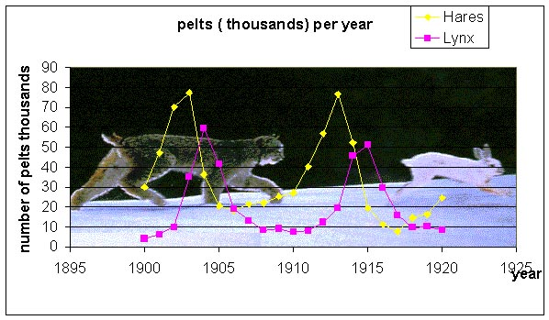
Predator-prey Relationships & Population Control
Numbers of pelts for hare & lynx were tallied in the early 1900’s to reveal how the number of hare influences the number of lynx.
Do you see a relationship?
What would result if there were no lynx?

Slide 8
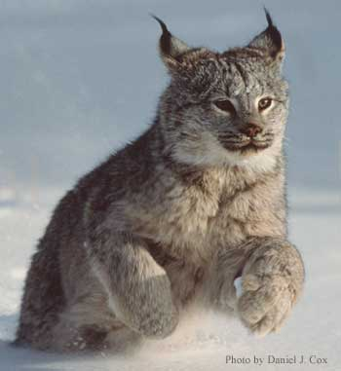
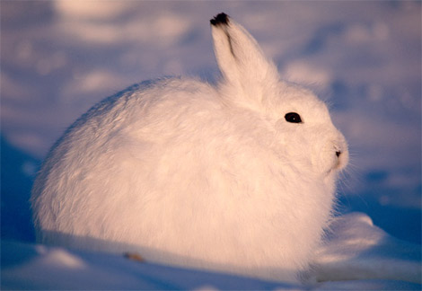
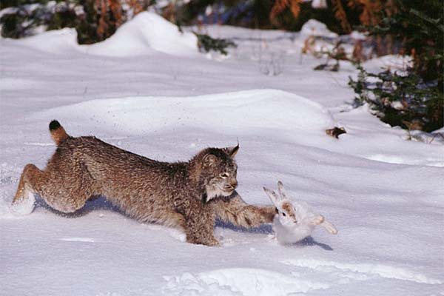
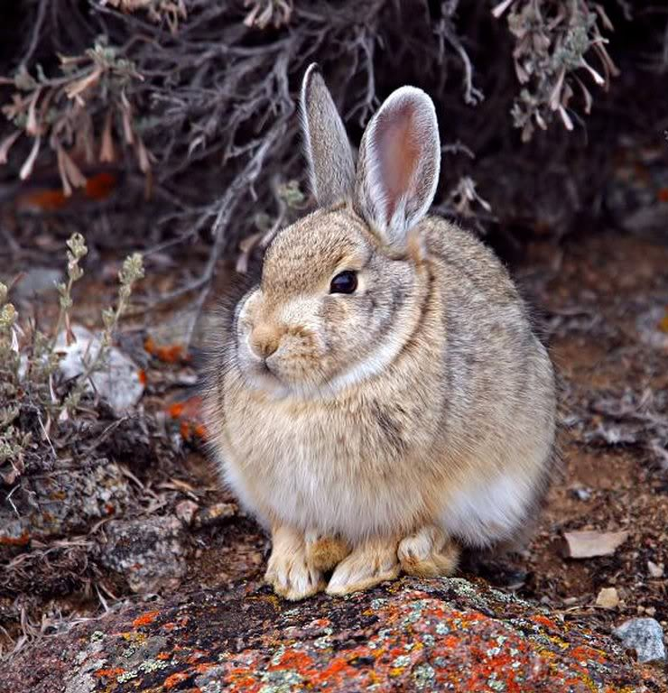
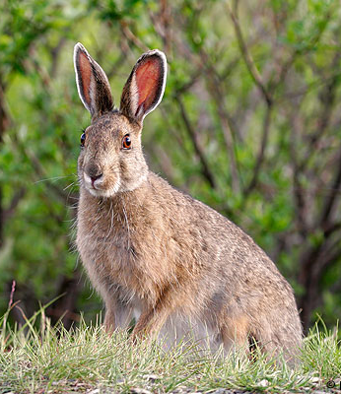
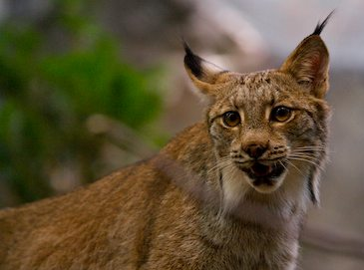
Predator-Prey Interactions, continued
Species that are involved in predator-prey or parasite-host relationships often develop adaptations in response to one another.
The lynx-hare relationship not only shows how predators and prey control each other’s population.
It also reveals that these two species have adapted together, over many generations.
This is a fundamental principle in evolution.
Hares are a certain color at different times in the year to achieve maximum fitness, or ability to survive and reproduce (a driving force concept in evolution).
Lynx have features that do the same.

Slide 9
Predator-Prey Interactions, Herbivory
Herbivores are animals that eat (prey on) plants.
Unlike predators, herbivores do not often kill/eat all the plants. But plants do try to defend themselves anyway.
Plants defend themselves from herbivores with thorns and spines or with bad tasting chemical compounds. These chemical compounds may even cause sickness or death.
And as adaptations allow for survival, some herbivores have evolved ways to overcome plant defenses.

Slide 10
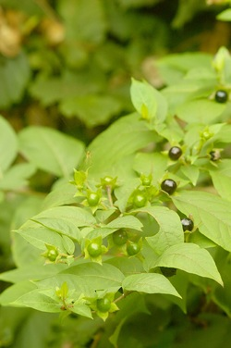
Natural Defenses by Plants
Belladonna:
“Belladonna is considered to be one of the most poisonous plants found in the Western hemisphere. Consumption three to five belladonna berries by children and five to ten berries by an adult can be fatal. Moreover, ingestion of a leaf of this plant can be lethal to an adult. The root is the most toxic part, but this can vary from one specimen to another.”
http://www.belladonnakillz.com/side-effects-belladonna-plant-revealed.html

Slide 11
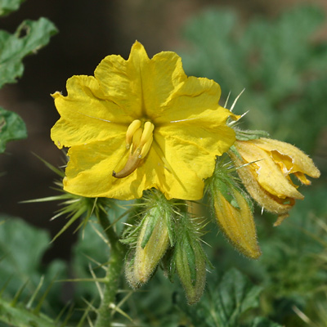
Poisonous Plants Native to Arizona
“Poisonous – The plants, especially the leaves and green fruit, are poisonous and contain the glycoalkaloid solanine as well as other tropane alkaloids. The plants can also accumulate toxic levels of nitrates from the soil.
Stinging or Itching – The numerous sharp spines on the plants and burs can cause intense, lingering pain if touched. Animals are also affected, and even after the burs are removed, dogs will continue to lick and chew on their feet because of the pain.”
http://www.fireflyforest.com/flowers

Slide 12
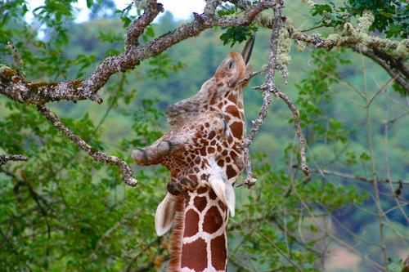
A Plant’s Defense Leads to an Animal’s Offense
What does a giraffe eat?
The giraffe lives on the Savanna, in the Sahara. It is dry and the green vegetation is very high! This suits the giraffe perfectly, they are herbivores, and eat a diet of around (75 lbs.) of leaves and twigs daily.
As ruminants (like cows), they first chew their food, swallow for processing and then visibly regurgitate the semi-digested cud up their necks and back into the mouth, in order to chew again.
Their favorite leaves are from the acacia tree. Acacia trees have long thorns that keep most animals from eating the leaves. But those thorns don't stop the giraffes! They simply use their 18-inch tongues, (yes you read that right, 18" tongues!) to reach around the thorns. Their tongues almost look bluish black in color, as you can see in the photo taken above.

Slide 13
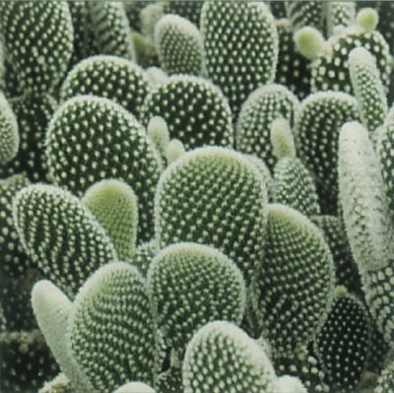
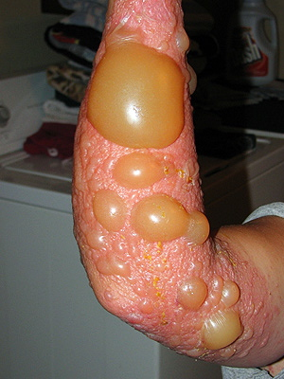
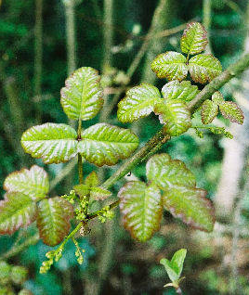
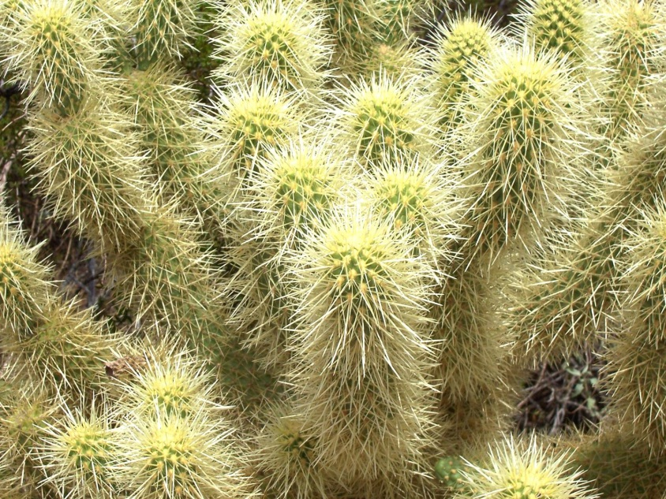
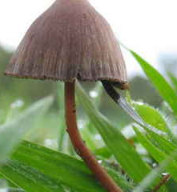
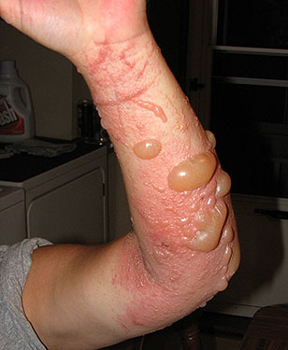
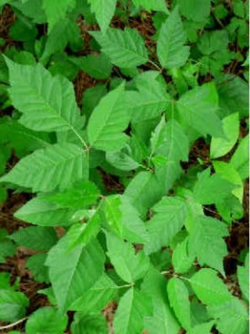
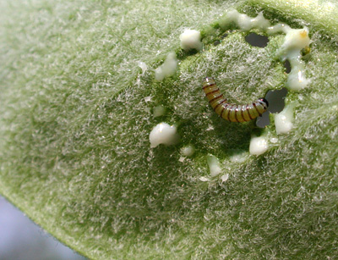
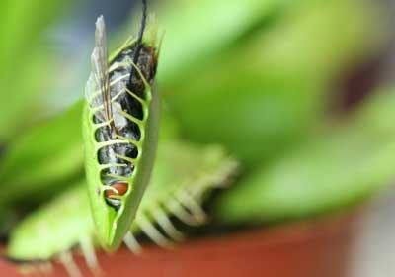
Just A Few More Ways Plants Get Animals To Not Eat Them…

Slide 14
Other Interactions… Symbiosis
Not all interactions between organisms result in a winner (getting fed) and a loser (being eaten).
Symbiosis is a relationship in which two species live in close association with each other.
  One lives in or on another species.
In some forms of symbiosis, one or both of the species benefit from the relationship.
  Take for instance E.coli in our gut. We both benefit from the interactions.
  Cleaner fish in an eel’s mouth.
  Dust mites that are attached to the base of your eyelashes.

Slide 15
Non-harmful Interactions
Mutualism and commensalism are two kinds of symbiotic relationships.
A relationship between two species in which both species benefit is called mutualism.
In commensalism, two species have a relationship in which one species benefits and the other is neither harmed nor helped.
Study the following graphics…

Slide 16
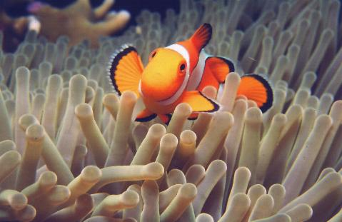
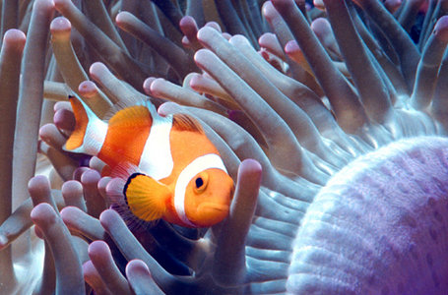
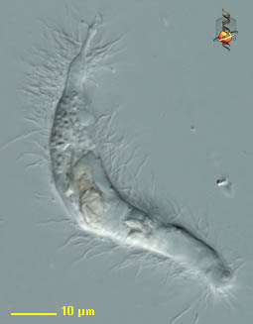
Examples of Mutualism
Clownfish and sea anemones: The clownfish benefits by having a protected home territory. Anemones benefit by having a cleaning crew.
Clownfish are small, brightly-colored fish found in coral reefs. They are frequently found in the tentacles of sea anemones, which typically capture their prey by paralyzing them with discharged cnidoblasts (nematocysts), and then ingesting the animal within the gastrovascular cavity. Studies have shown that a component of clownfish mucus inhibits the discharge of these cnidoblasts. Clownfish and sea anemones present an example of facultative mutualism.
Termites and intestinal flagellates: Termites benefit from having access to the energy in cellulose & the bacteria has the benefit of having a constant food source.
Although termites can physically chew and ingest wood, they are incapable of chemically digesting cellulose into sugars. They rely on intestinal flagellates, e.g. Pyrrsonympha spp. and Trichonympha spp. which are capable of digesting cellulose. These genera of flagellates reside in the hindgut of termites and provide nutrition for them. They are not found anywhere else in nature. When a termite molts, it loses its hindgut and therefore loses its population of flagellates. It reinfects itself by ingesting its (or some other termite’s) hindgut that has been eliminated. (A pleasant thought, yes?) A specimen of Pyrrsonympha is shown here.

Slide 17
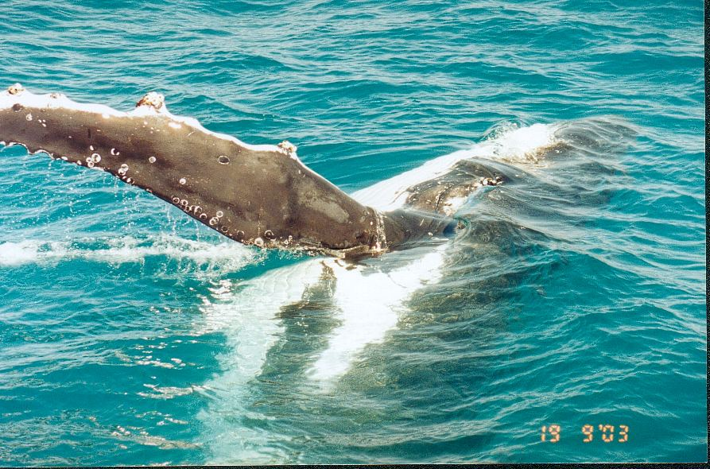
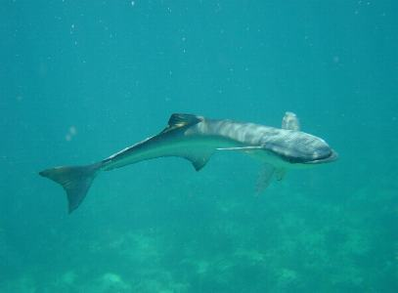
Commensalism
Barnacles on a humpback whale
  Uses the whale to be transported to other sources of food, sometimes thousands of miles.
Remora shark
  Attaches to whales to feed by way of a sucker pad on the top of its head.

Slide 18
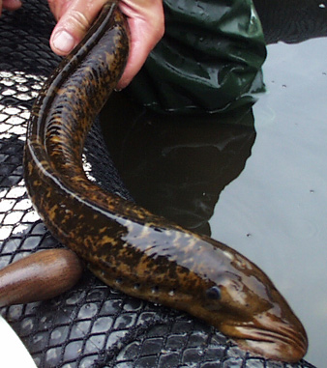
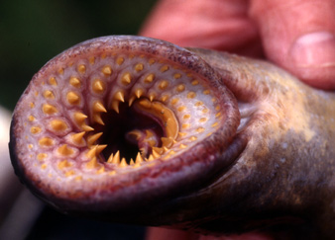
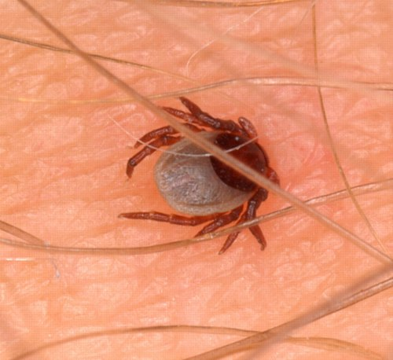
Parasite – Host Relationship
In parasitism, one organism (the parasite) feeds on another organism called a host.
The host is almost always larger than the parasite and is usually harmed but not killed.
Parasites often live on or in their host. Therefore, the parasite depends on its host not only for food but for a place to live as well.
Examples:
  Ticks/flees, tapeworms, bacteria, lampreys

Slide 19
Predator-Prey Interactions, Parasite-host
Co-evolution happens in this relationship too.
For example, hosts evolve with strategies to prevent parasites from infecting them. They defend themselves with their immune systems or with behaviors such as scratching.
In response, parasites may evolve ways to overcome the host’s defenses with such adaptations as strong hooks or chemicals that mask their presence.

Slide 20
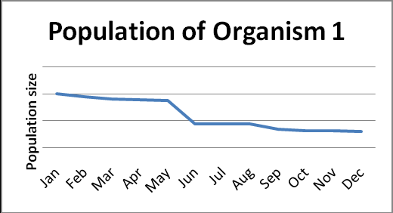
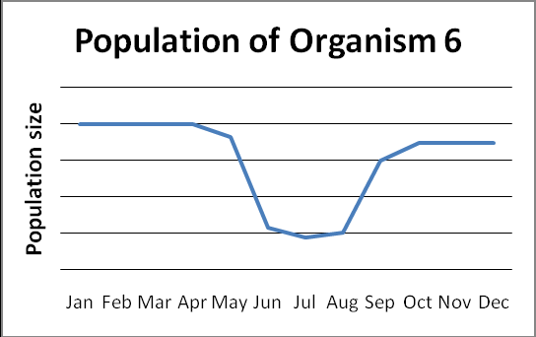
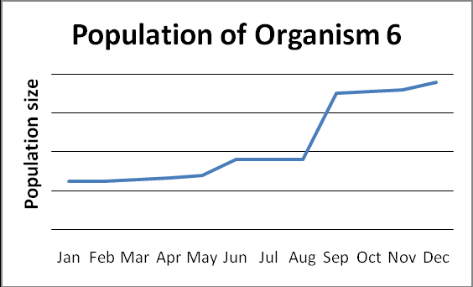
Organism 1 is the common prey for coyotes in the Sonoran Desert. If predator population is dependent on prey available, which graph do you think represents the population graph for coyotes during the same time frame?
A
B
C

Slide 22
Summary
Species that involve predator-prey or parasite-host relationships often develop adaptations in response to one another.
Mutualism and commensalism are two types of symbiotic relationships in which one or both of the species benefit.
Link to Predator Video

